Slide 1
Competition Resources

Slide 2
Online resources
Sustainability and sustainable resources: https://www.bbc.co.uk/bitesize/guides/znmnb9q/revision/1
Intro to sustainability and sustainable definitions. Description of sustainable resources, including renewable and non-renewable energy definitions
Sustainable countries, cities, and homes: https://www.bbc.co.uk/bitesize/guides/zsxsgk7/revision/1
BBC bitesize resource including info on how location can effect grid mix, planning for sustainable transport,
and sustainable building design
Sustainable food production: https://www.bbc.co.uk/bitesize/guides/zf6fr82/revision/1
BBC bitesize resource highlighting risks associated with globalisation of food, food miles, carbon footprints of food, waste, and the concept of fair trade
Circular Economy: https://www.ellenmacarthurfoundation.org/resources/learn/schools-colleges-resources
Introduction to circular economy. Lesson plans covering what circularity is, the issues associated with excessive use of finite resources, and specific information pertaining to future cities and modern agriculture

Slide 3
Videos
Operation sustainability: https://www.youtube.com/watch?v=RMx3bcTlxqY
Five-minute cartoon outlining some of the key sustainability issues, and an introduction to the UN Sustainable Development Goals
Sustainability Explained: https://www.youtube.com/watch?v=_5r4loXPyx8
Four-minute video introducing the concept of sustainability and the three pillars

Slide 4
Composites
Composites are combinations of two or more materials that perform better when they’re together rather than separate such as carbon fibre!
String
Glue
Composite
Reinforcement
Matrix
+
=
Very strong
Weak
Very strong
Floppy
Stiff – when dried
Stiff
Notes:
Explain that windmill blades could be made from wood and cloth but wind turbine blades need to much longer, stronger and stiffer. Metal would be too heavy so we use composites!

Slide 5
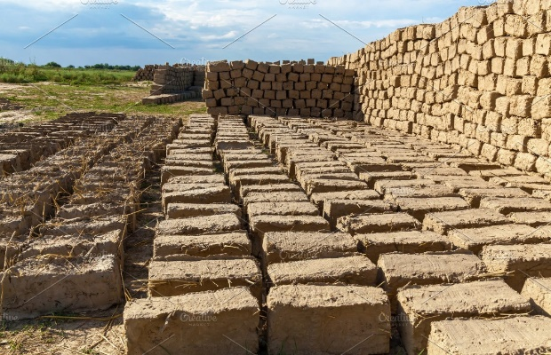
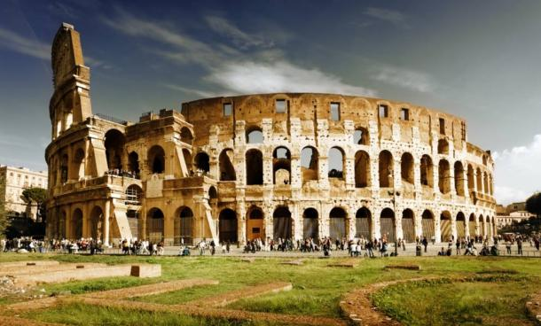
Composites – Traditional Applications
Straw + mud = bricks
Sand + cement = concrete
Wood pulp + water = paper
Notes:
Here are examples of how composites have been used through out history.
Now composites are used more and more, what needs to be light but strong? Prompt F1 cars, boats, airplanes, bikes, wind turbines etc

Slide 6
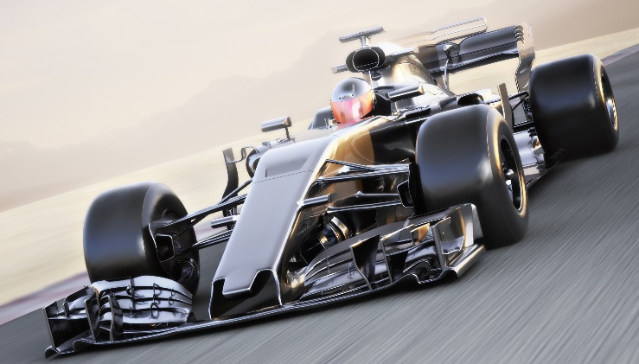
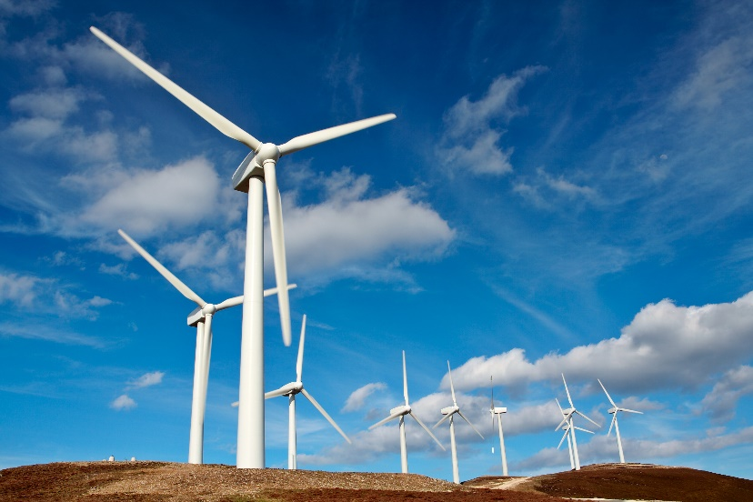
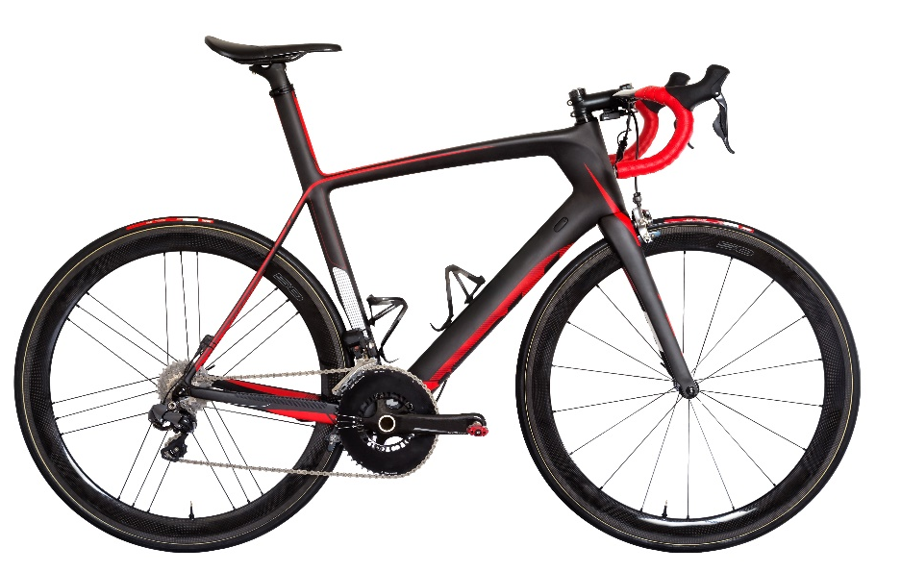
Composites – New Applications
Notes:
Here are examples of how composites have been used through out history.
Now composites are used more and more, what needs to be light but strong? Prompt F1 cars, boats, airplanes, bikes, wind turbines etc

