Slide 1
Secondary School – Innovation and Sustainable Composites Lesson Plan
Presenter details

Slide 2
Objectives
Identify
Explain
Apply
Be able to identify and explain what a composite material is and the ways they could be made more sustainable
Understand the term Innovation and how this can link to the 3 R’s
Apply your knowledge of innovation and composites to a ‘real life’ case study
Research and produce a design sheet showing your proposal for a greener future

Slide 3
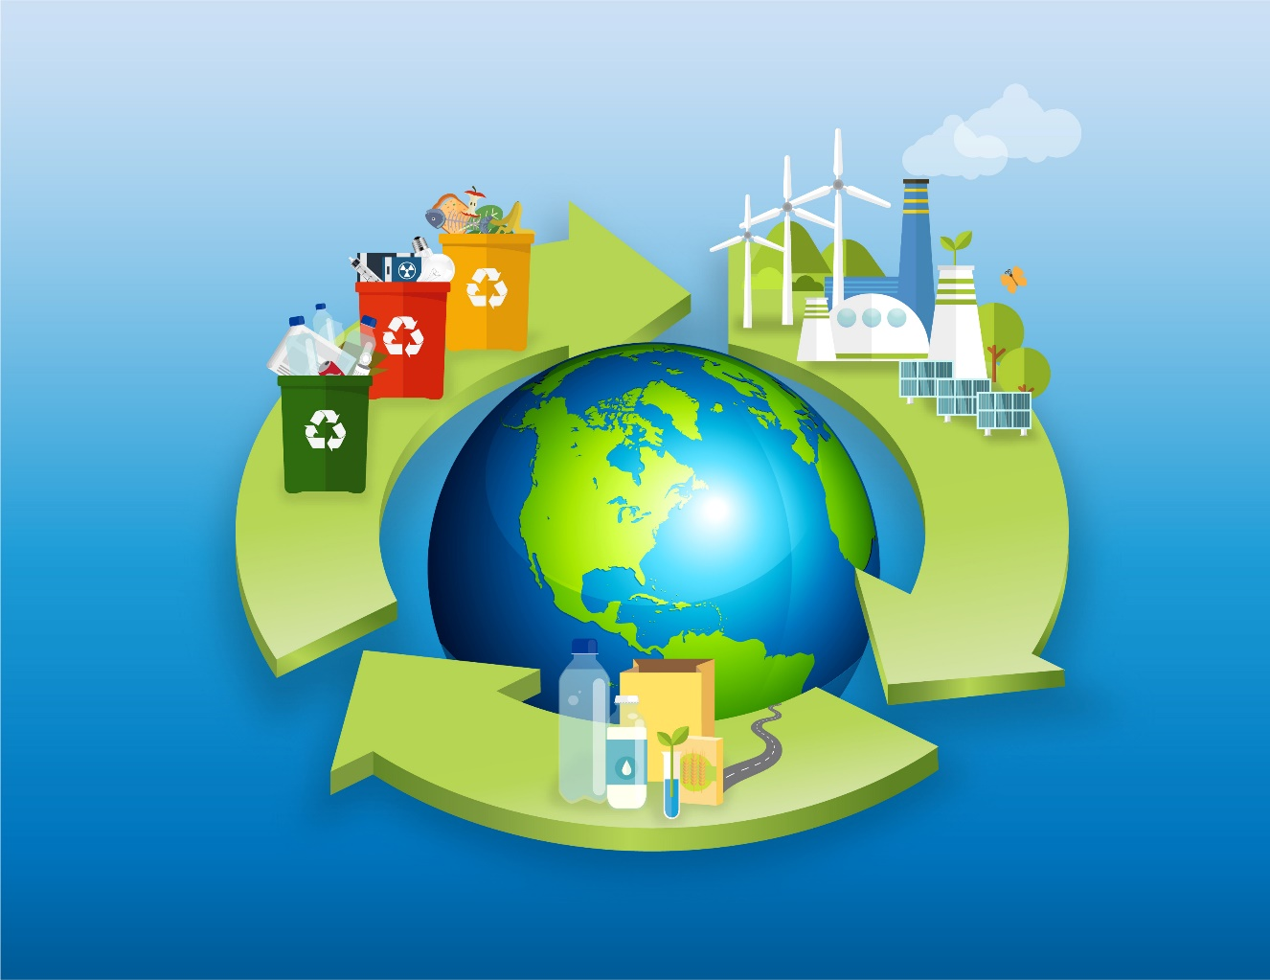
Our aim is to create a healthier society, cleaner environment and a vibrant UK economy
TASK: Map out how you think companies might go about tackling the above
Notes:
Teacher notes:
How do you think companies might go about doing this?
Ask groups to map out the above question as this will be the starting point behind their project.

Slide 4
Examples of UK industries making a difference
Oceanium Ltd is a seaweed processing company that purchases sustainably-farmed seaweed from UK seaweed farmers and uses the biomass to create food products and sustainable bio-packaging.
Biome Bioplastics produce bioplastics with the potential for increased sustainability and biodegradability properties, creating significant environmental and economic impacts.
British supermarket chain Waitrose introduced a new fleet of eco-friendly delivery vans. The vans run on biomethane, a sustainable alternative to fossil fuels.
Clothing and bedding manufacturers have started using bamboo due to its anti-bacterial, wicking, and biodegradable properties.
Tackling the problem of marine plastics while enabling the blue economy in the UK
Using biome technologies to create a biodegradable alternative to oil based plastics
Using food waste to power eco-friendly delivery vans, creating a sustainable fuel source
Bamboo is a fast-growing, renewable, and easy-to-grow material that requires zero chemicals and pesticides.
But what can we do with waste that isn’t biodegradable?

Slide 5
Sustainable Composites partnership
Composites are two or more distinct materials that when combined give better properties than when apart.
The component materials don’t completely blend or lose their individual identities; they combine and contribute their most useful traits to improve the outcome or final product.
Composites are typically designed with a particular use in mind, such as added strength, efficiency or durability.
VIDEO: https://youtu.be/-ANQRfepXOY
Notes:
Teacher notes:
Watch the video and ask them to add to their map any points they may think relevant from the video.

Slide 6
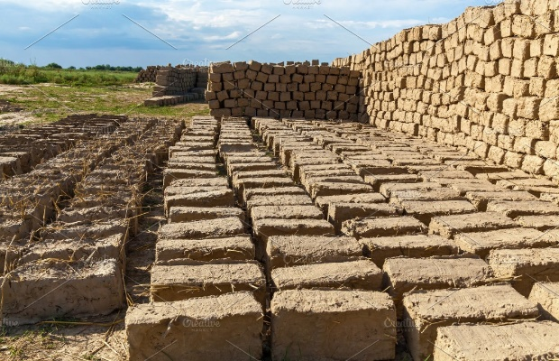
Composites aren’t new!
Straw + mud = bricks
Sand + cement = concrete
Wood pulp + water = paper
Notes:
Teacher note
Can you think of any others?

Slide 7
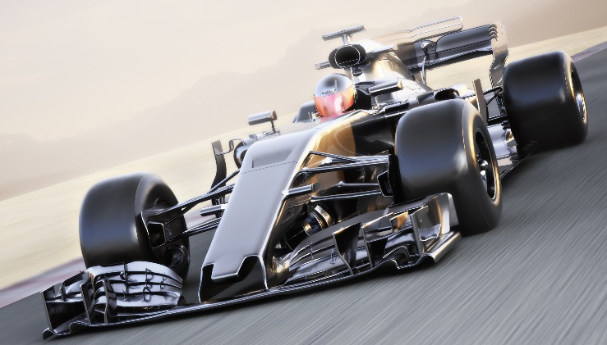
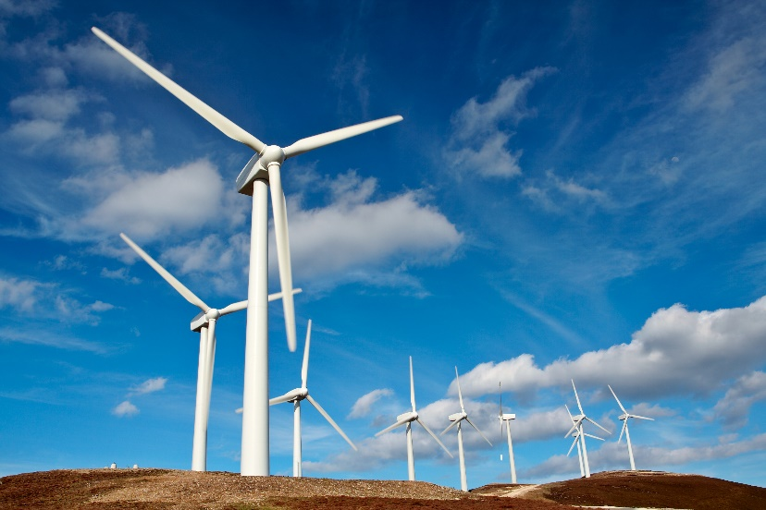
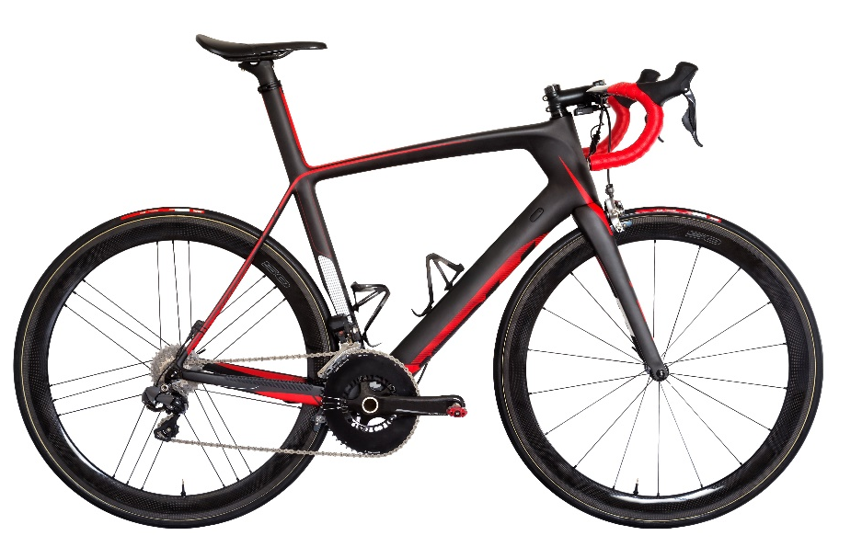
Modern examples of composites
Notes:
Teacher notes:
Composites can be found in lots of different sectors

Slide 8
What do we mean by ‘sustainability’?
Sustainability is meeting the needs of today without inhibiting the ability of future generations to meet their own needs
We recognise that sustainability covers all aspects of human life, and information on the UN’s 17 Sustainable Development goals can be found here.
Notes:
Teacher notes: What do the students think sustainability is?

Slide 9
The concept of innovation
Innovation is not invention, it is about taking an idea and making it a reality.
Innovation is:
Turning an idea into a solution that adds value
The application of ideas in a novel way
Creating a new market, or radically changing an existing one.
An introduction of new products, processes and services that add value to the user
VIDEO: https://www.youtube.com/watch?v=HjVkuxH6GdE
Notes:
Teacher notes:
What is innovation?
An example of this would be taking something already available and making it better!
Insulin injections are needed for people who have diabetes. You have to test the blood periodically to know how much insulin you need (this is done via a punch needle). What if you didn’t need to take your blood and you could wear a patch on your arm that tested you without the need to penetrate your skin? What if it then sent the results to your phone? What if the phone could send you notifications of when you need an injection?

Slide 10
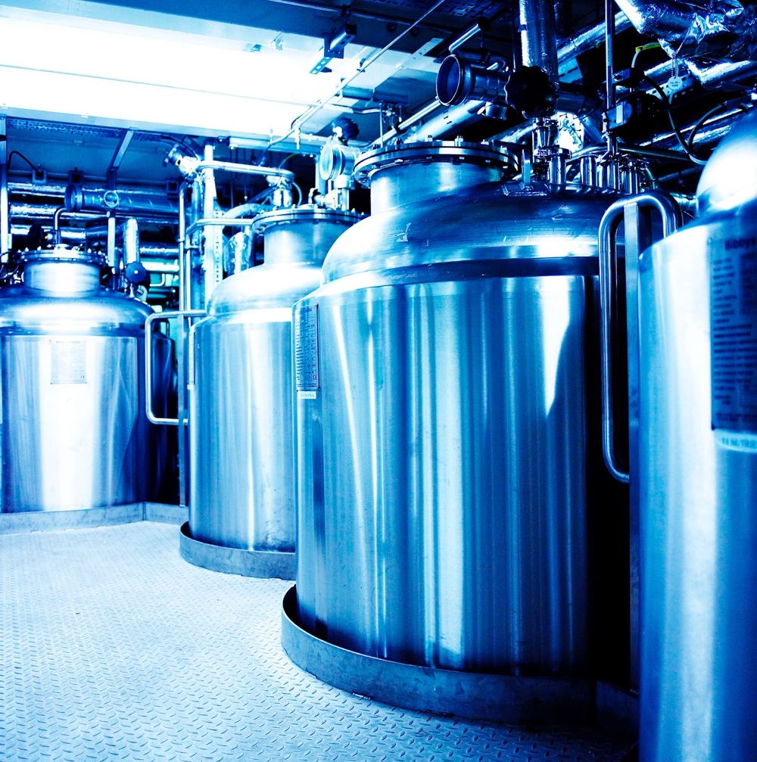
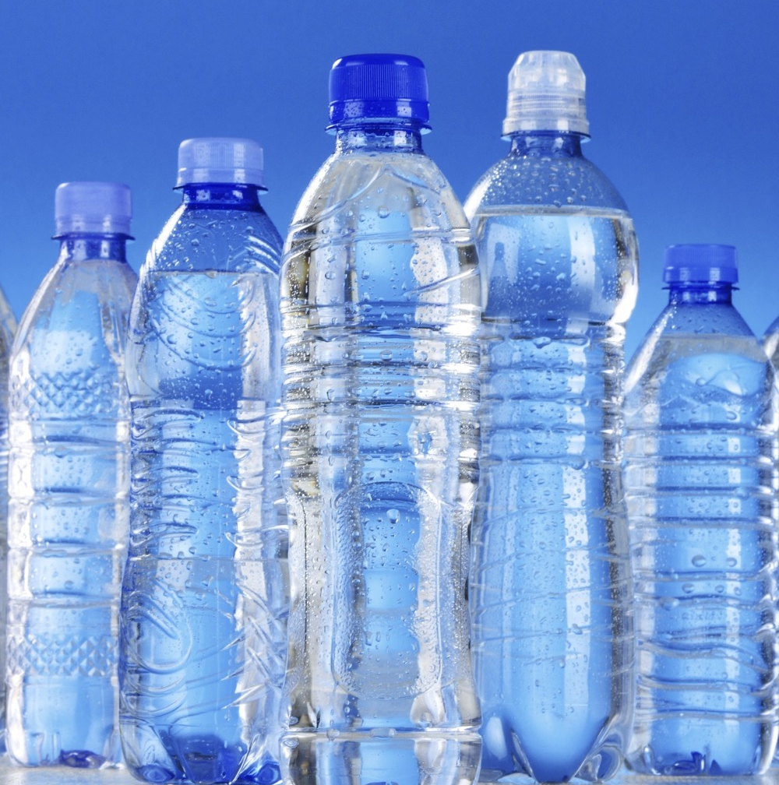
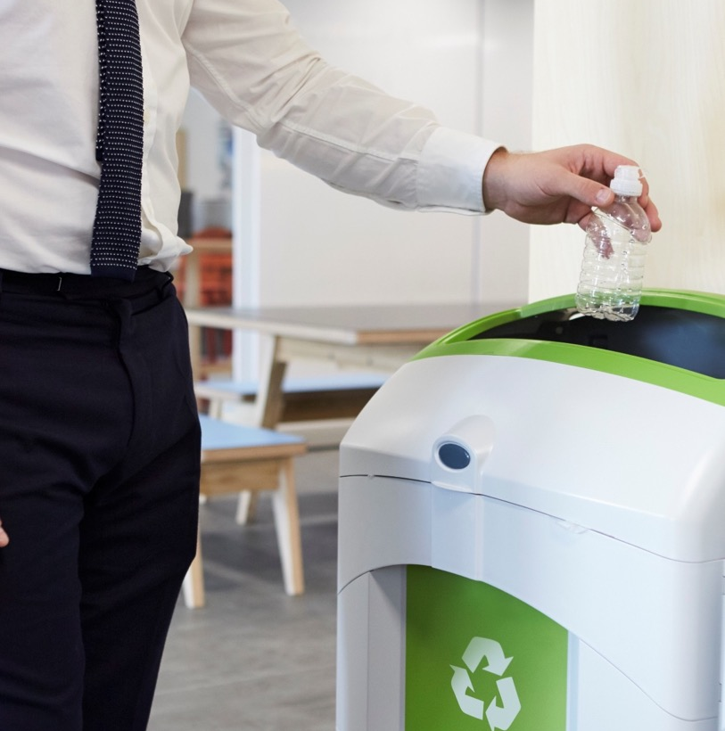
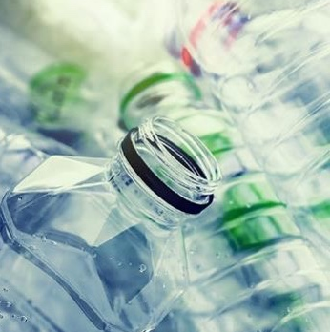
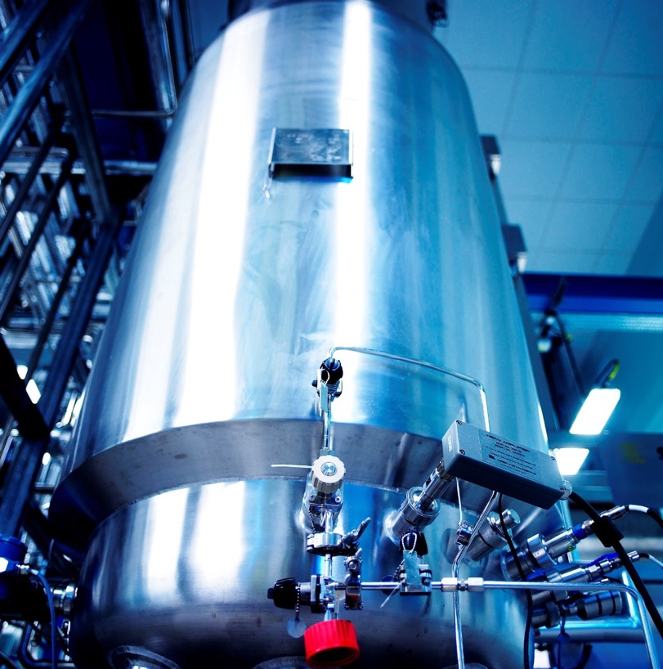
Bringing Innovation and Sustainability together
Sustainably sourced plastic packaging
Promoting re-use
Developing sustainable packaging materials
Encouraging recycling
Minimising packaging material used
End of life processing

Slide 11
Reduce
Reuse
Recycle
Case Study: https://www.youtube.com/watch?v=52tJvUsOO5A
Notes:
Teacher notes:
Research task – Ask the groups to look at the case study on aeroplane end of life process.
They are to come up with a proposal on how they would repurpose the aeroplane to reduce the waste going into landfill.

Slide 12
Group task
You don’t have to do this alone!
Working in industry is about effective collaboration and communication
You can work individually or in groups in groups of up-to 3
Use each other for help and guidance. Don’t be protective of work!
Notes:
Teacher notes:
This can be presented on A3 and should show what they intend to do with the plane. This can be to recycle what they can and then re-purpose, it could be to repurpose all of it? The list is endless.
The groups will need to present this (remembering the concept of innovation) and present the idea. The class will then pick their favourite and most viable.

Slide 13
Objectives
Identify
Explain
Apply
Be able to identify and explain what a composite material is and the ways they could be made more sustainable
Understand the term Innovation and how this can link to the 3 R’s
Apply your knowledge of innovation and composites to a ‘real life’ case study
Research and produce a design sheet showing your proposal for a greener future
Notes:
Revisit the objectives

