Slide 1
Primary School – Wind Turbine Lesson Plan
Presenter details

Slide 2
By the end of this lesson we will…
Be able to explain the difference between renewable and non-renewable energy
Understand how a wind turbine creates energy
Test how different variables affect how much energy a wind turbine creates
Date:

Slide 3
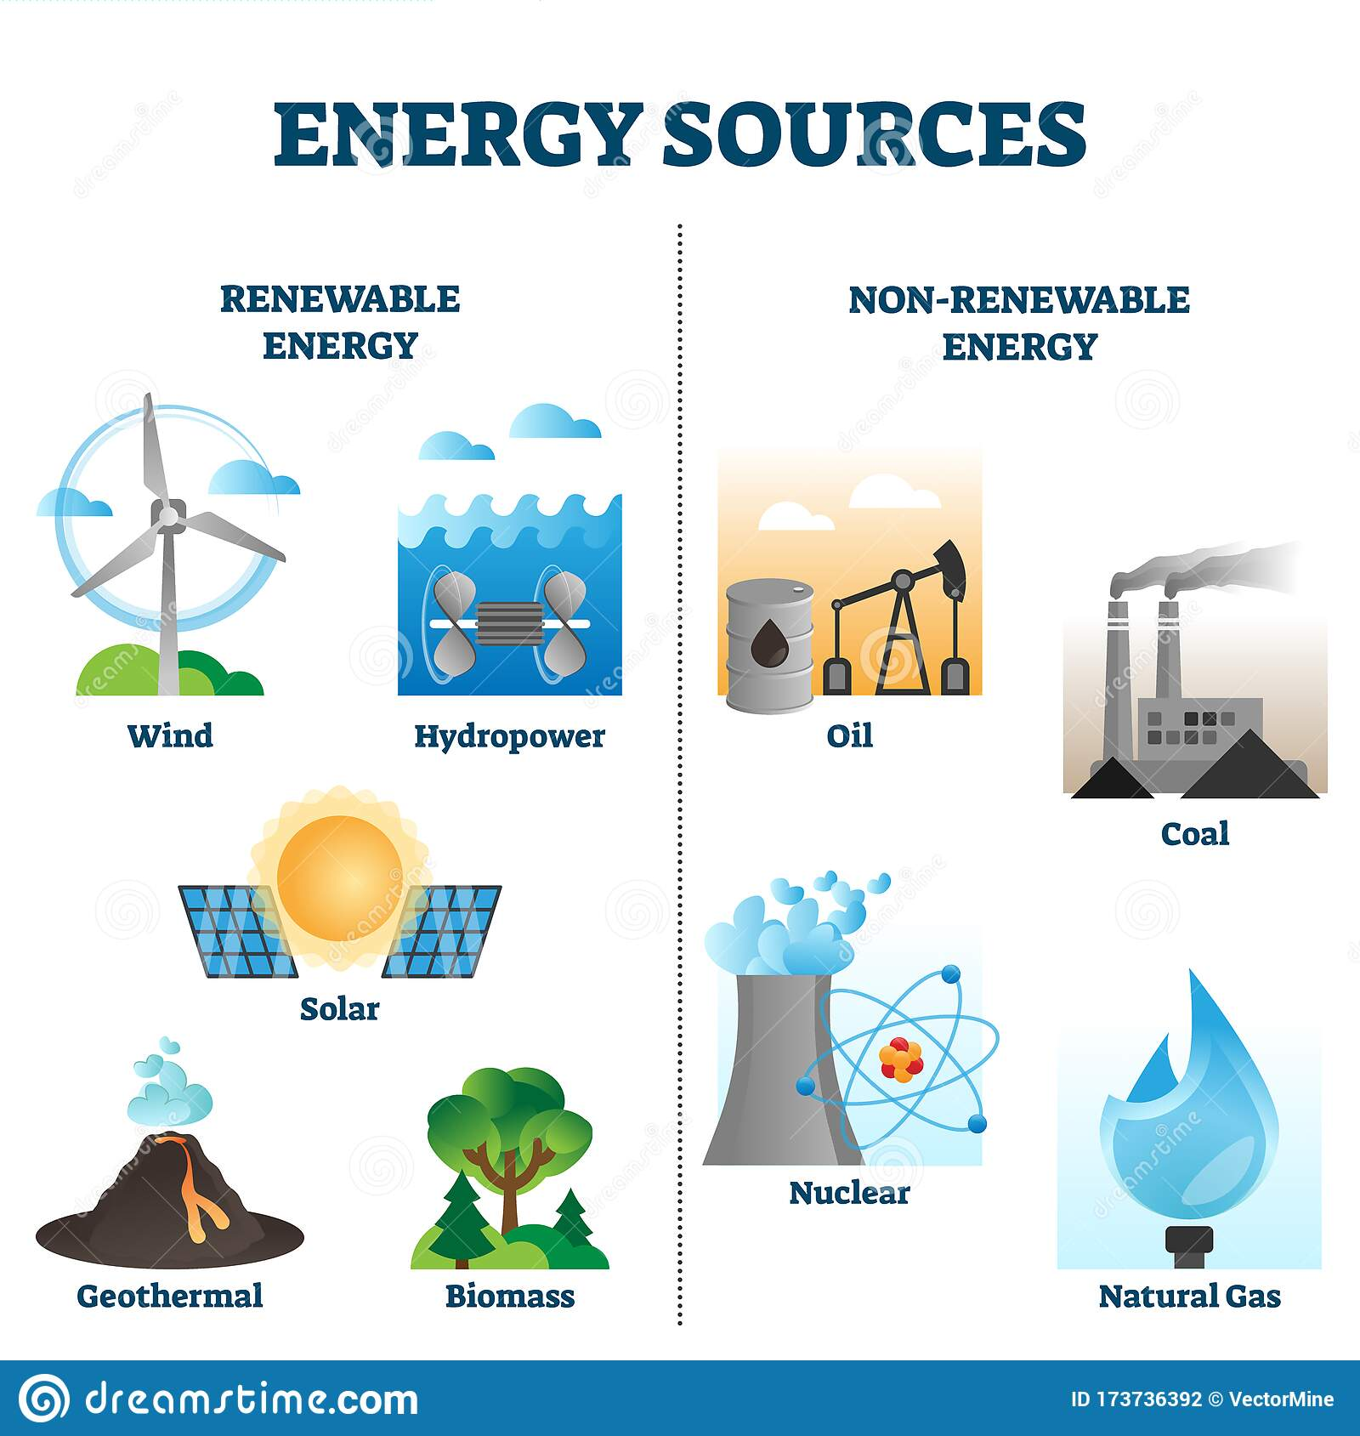
Different types of energy
Renewable energies generate from natural sources that can be replaced over a relatively short time scale.
Non-renewable energies come from resources that are not replaced or are replaced only very slowly by natural processes.
Date:
Notes:
Discuss the differences between renewable and non-renewable resources. What is the students’ understanding of these terms? What do the students think the future holds for how we get our energy?
https://www.bbc.co.uk/bitesize/topics/zp22pv4/articles/ztxwqty
Renewable sources
Wind
Solar
Water
Non-renewable
Nuclear
Fossil fuels

Slide 4
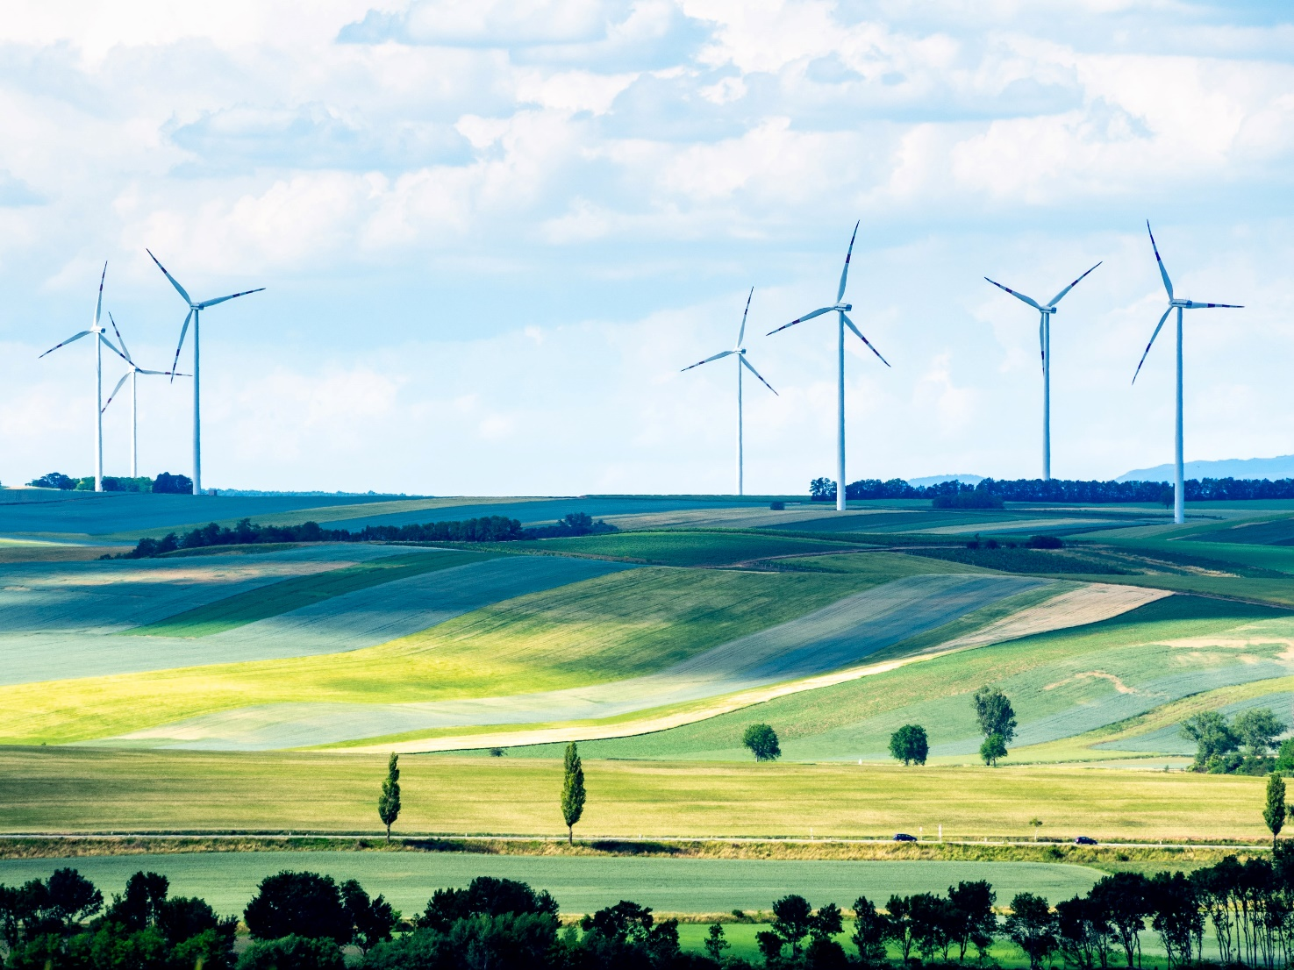
Wind turbines – what are they and how do they work?
Date:
Notes:
Ask the students…
Who has seen a wind turbine before?
What do you think they are made of?
How do you think they work?

Slide 5
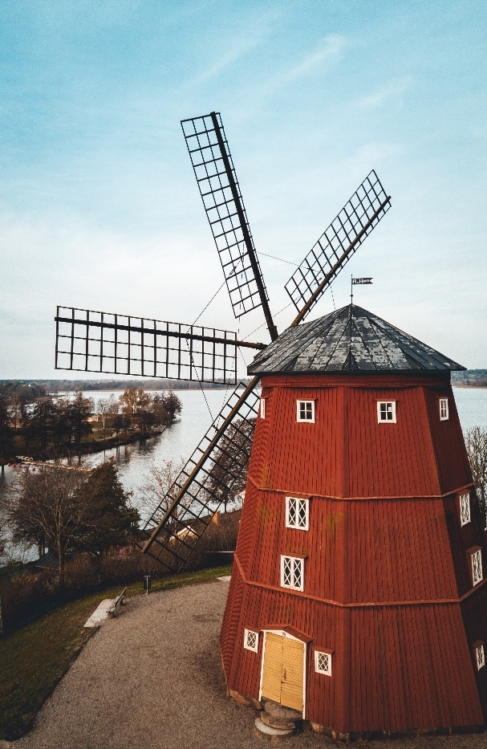
Wind turbines – what are they?
A wind turbine is the very modern version of a windmill. Windmills used the wind to turn a grindstone and make flour and now wind turbines turn a motor which generates electricity.
Notes:
Explain that today’s lesson is going to concentrate on wind turbines.

Slide 6
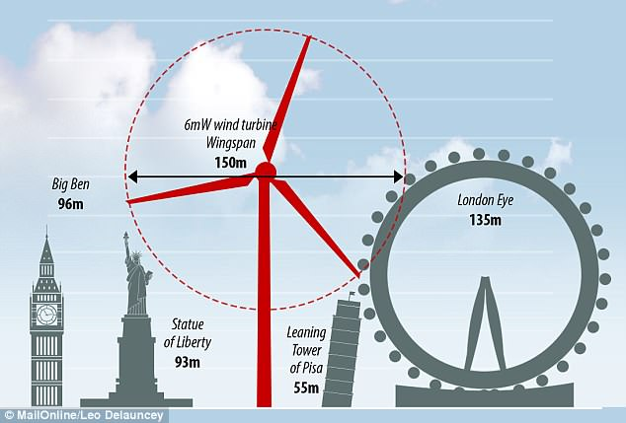
Wind turbines – what are they?
Where do you see wind turbines?
They tend to build wind turbines where we have the most wind! This can be at sea or on hillsides.
How tall is a wind turbine?
Notes:
Explain that today’s lesson is going to concentrate on wind turbines.
Ask the students how tall they think a wind turbine is and where they can be located.

Slide 7

Wind turbines – how do they work?
blades
When the wind blows it pushes the blades on the turbine causing them to rotate.
The spinning blades are connected to a shaft which is then connected to a gear box. This gear box helps the blades spin faster.
The gear box is connected to a generator which produces the electricity. The turbines are also fitted with a brake.
Wind
generator
gear box
shaft
Wind
brake
Date:
Notes:
Explain that turbines need to spin fast in order to produce electricity.
Image - https://www.sustainablelearning.com/

Slide 8
Wind turbines – what are they made of?
If we want more electricity, we need bigger wind turbines!
The problem is, what do we make them out of?
Wooden blades aren’t strong enough and metal is too heavy...
We need something that is the best of both!
Date:

Slide 9
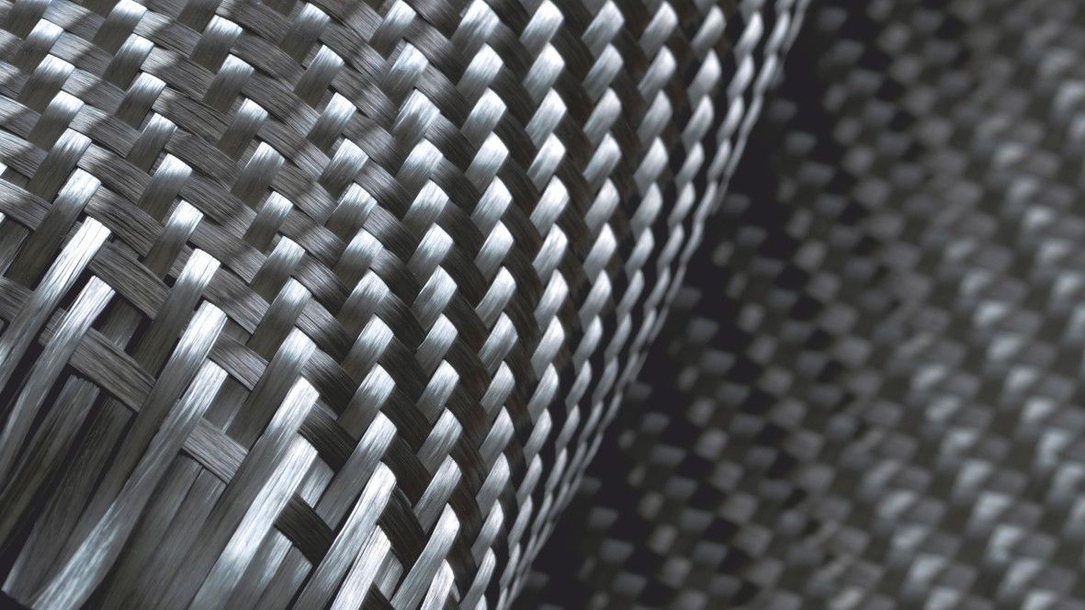
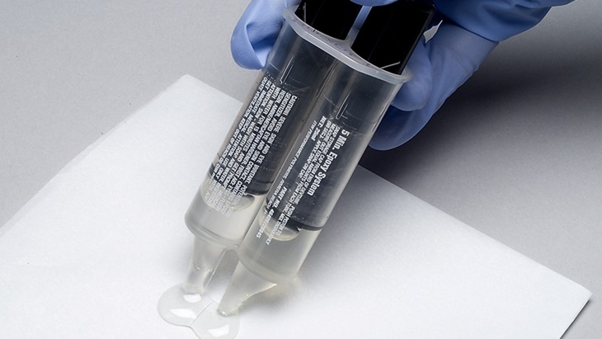
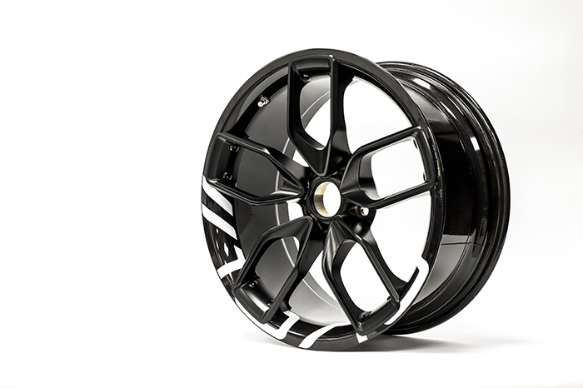
Wind turbines – what are they made of?
Most of a turbine is made from metal but the blades are now made of composites.
What’s a composite?
Composites are combinations of two or more materials that perform better when they’re together rather than separate such as carbon fibre!
String
Glue
Composite
Reinforcement
Matrix
+
=
Very strong
Weak
Very strong
Floppy
Stiff – when dried
Stiff
Notes:
Explain that windmill blades could be made from wood and cloth but wind turbine blades need to much longer, stronger and stiffer. Metal would be too heavy so we use composites!

Slide 10
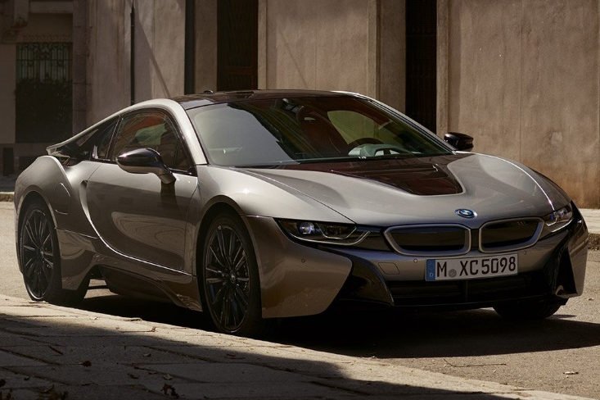
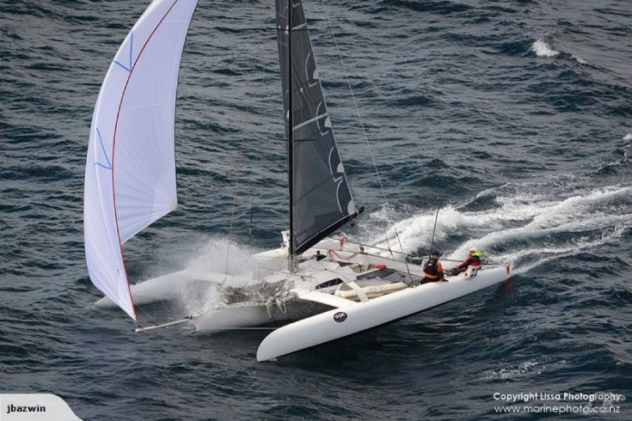
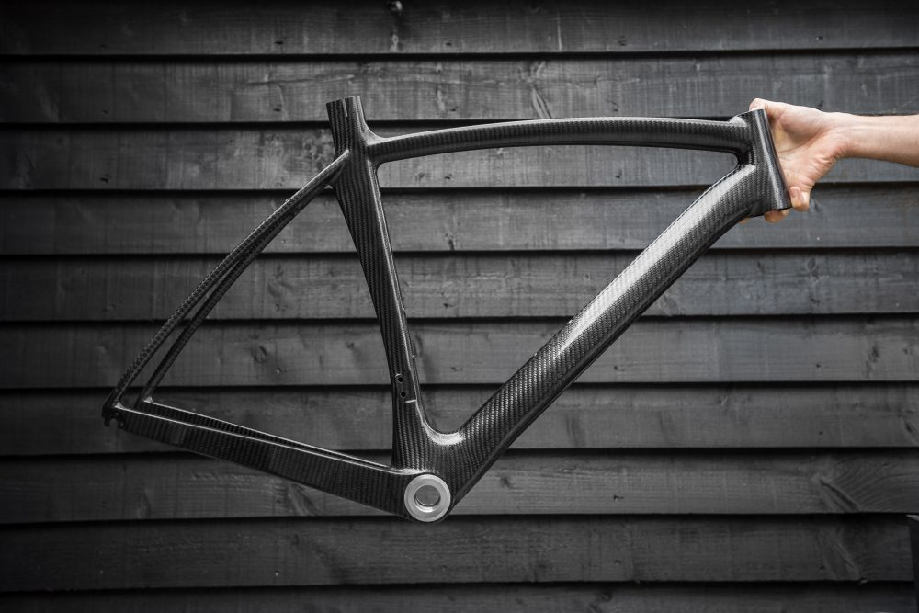
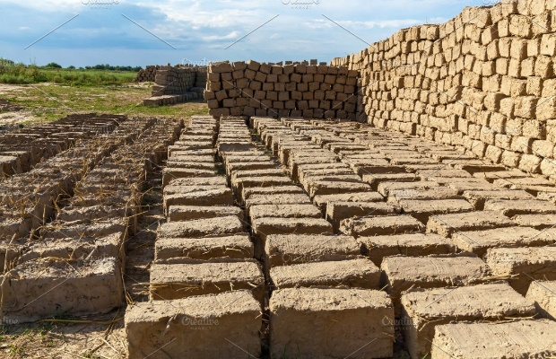
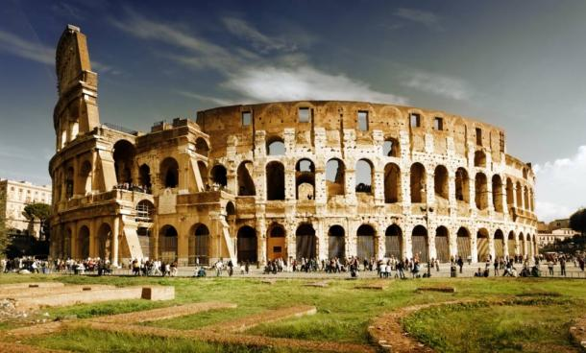
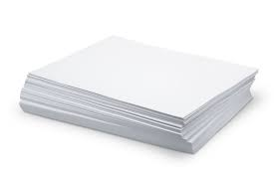
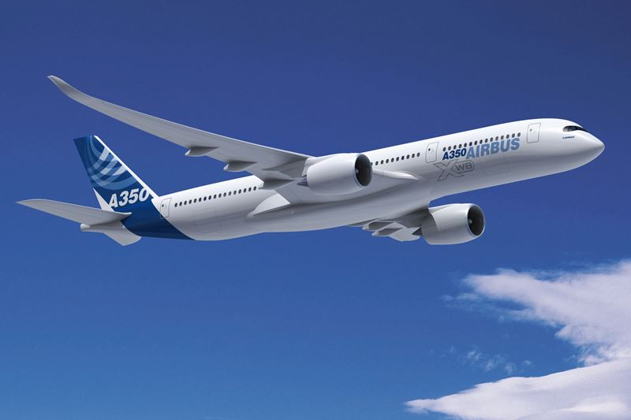
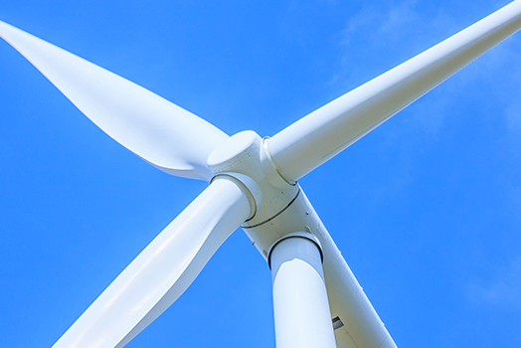
Composites – old and new!
The wind turbine blade is the bit that has to spin in the wind, so they need to be light but also strong and stiff. This is what composites are, so they’re perfect.
These properties mean that we can make really long blades that are easier to catch in the wind and so they generate more electricity.
But composites aren’t new!
Straw + Mud Bricks
Sand and cement - Concrete
Wood pulp + water = Paper
Notes:
Here are examples of how composites have been used through out history.
Now composites are used more and more, what needs to be light but strong? Prompt F1 cars, boats, airplanes, bikes, wind turbines etc

Slide 11
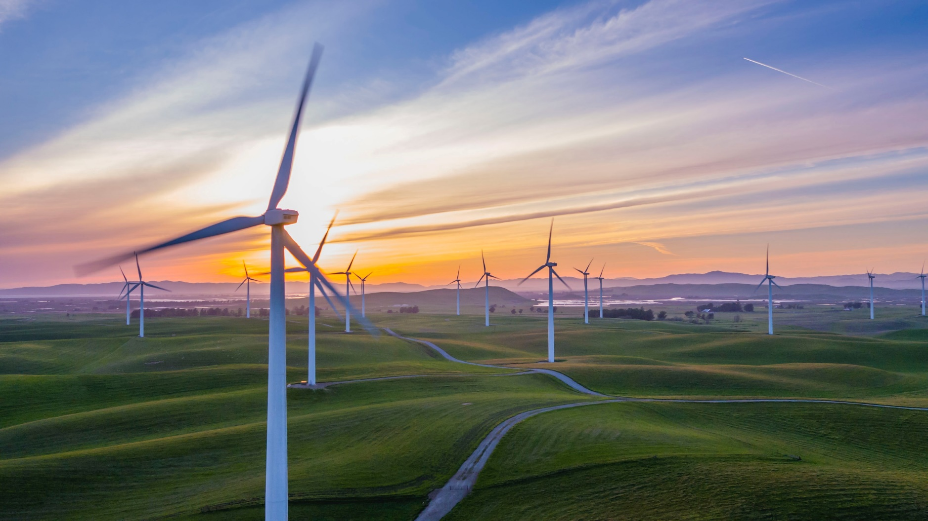
Make a wind turbine – which will create the most energy?
Date:
Notes:
Explain to the students that they are going to be replicating how the energy generated from wind can be used to power a mechanism. This will be a 1 meter line of thread. They will use a fan or hair dryer (set on cold blow) to replicate the wind. They will then need to time how long it takes to turn the blades and wind the thread. More energy = the thread winding faster!
See worksheet for creating the wind turbine.
Working in grounds of around 4 the students should choose one variable to change about their blade design. E.g, different material for the blades or more blades for the turbine. All other variables will need to be fixed to ensure the experiment is a fair test.
Before they start their experiment, each group should decide what question they are attempting to answer. For example, how does changing the material of the wind turbine blades affect the output of energy?
Each group should the make a prediction for their findings. For example, I predict that a turbine with 6 blades will raise the weight the fastest because there are more blades for the wind to hit.
Encourage the students to think scientifically and completing the process of drawing on their prior knowledge and experiences, planning their experiment, making a prediction, testing, observing, recording results, drawing conclusions.
Allow the students to complete their experiments recording their results as they go.

Slide 12

What have we learnt?
Be able to explain the difference between renewable and non-renewable energy
Understand how a wind turbine creates energy
Test how different variables affect how much energy a wind turbine creates
Date:
Notes:
Ask students what they learnt and check objectives were met.
What did they enjoy about making the wind turbines?

